Slide 1




Deeni Ta’alimi Board
Goal
The Deeni Ta’alimi Board's overarching goal is to ensure that 100% of Muslim children receive basic religious education, fostering a connection with their faith. To connect maktab with darul ulooms, and to educate all sections of the Muslim Community.
Founded in January 1955
Dedicated to providing essential religious education for Muslim children.

Slide 2


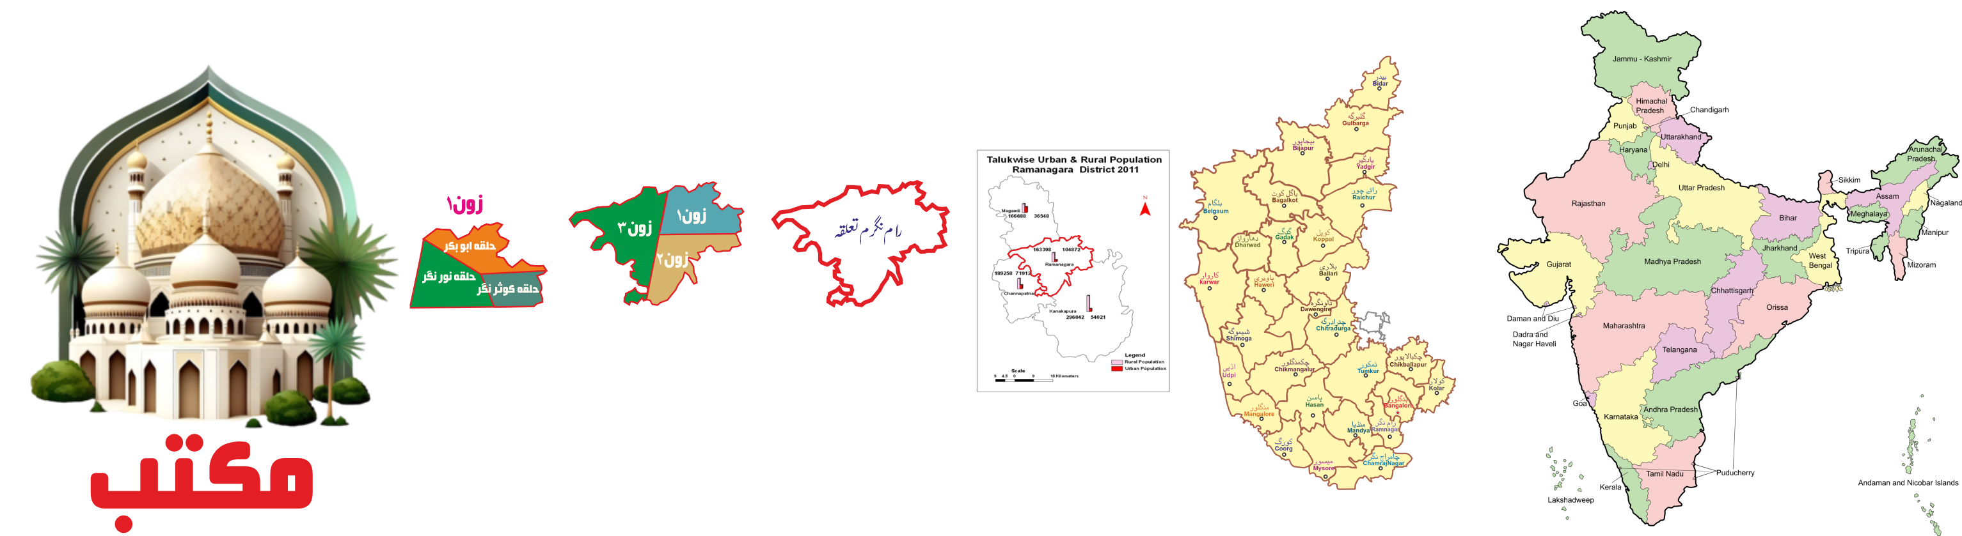
Deeni Ta’alimi Board
Journey so far
Total Students:
27,90,510
58,319
Total Maktabs
Trained Teachers: 17,093
21,315
Trained Maktab Supervisor: 560
Organized Maktabs

Slide 3

Deeni Ta’alimi Board
Ongoing Activities
A dedicated Research and Development Center has been established in Bangalore, focusing on curriculum, education and innovation.
A new book series, "Deeni Taalimaat," was published in 2016 to meet modern needs, offering content in an accessible and engaging style.
We conduct annual board examinations in which students from all affiliated maktabs across the country appear.

Slide 4
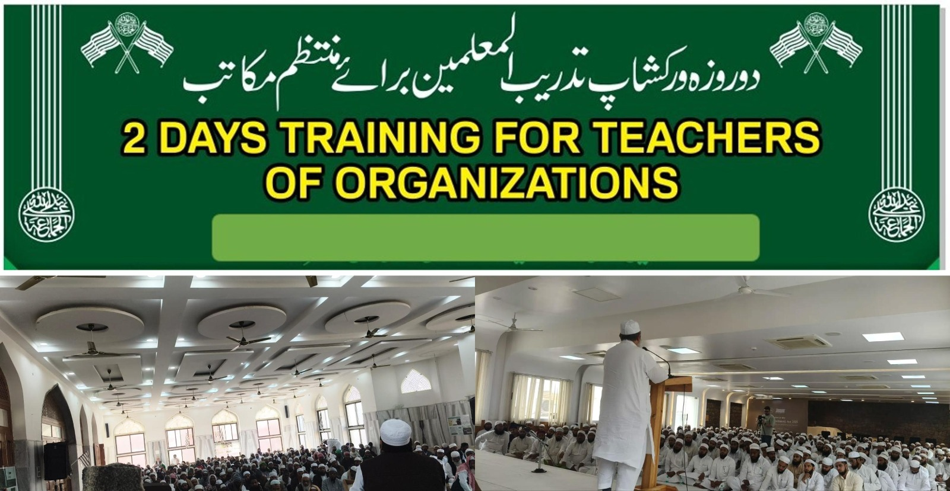
Deeni Ta’alimi Board
Image of three-day training event for maktab teachers

Slide 5
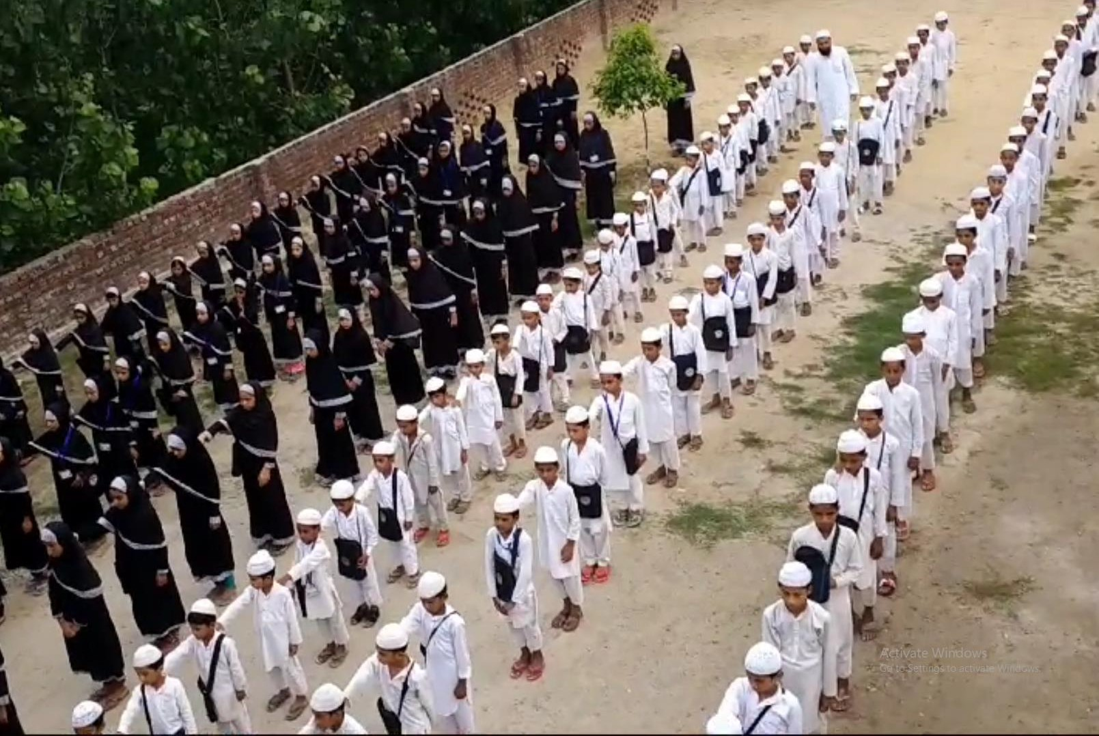
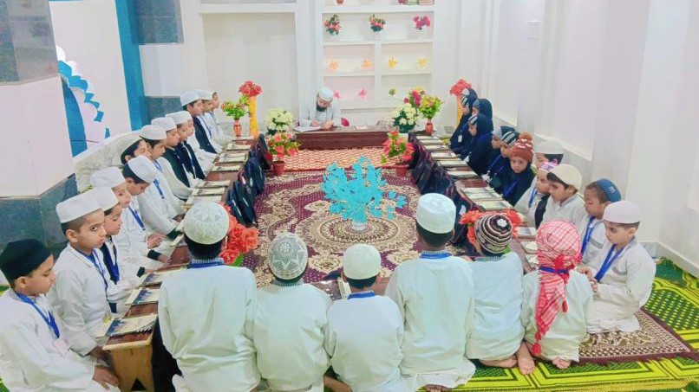
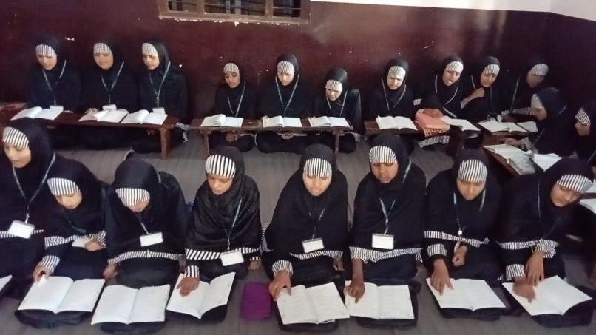
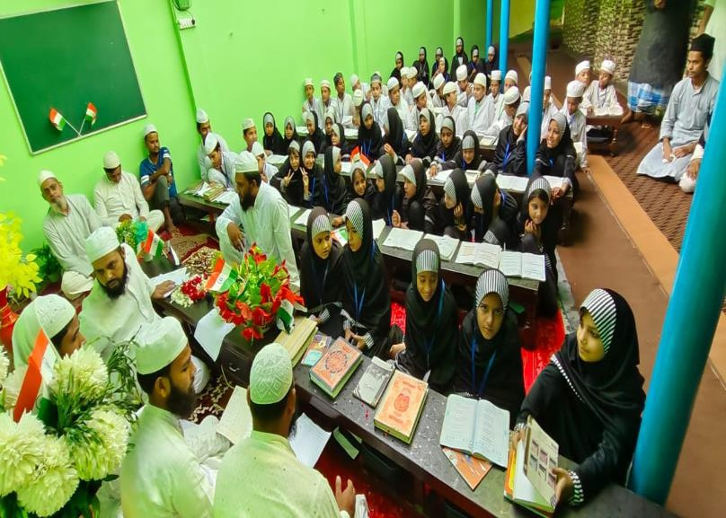
Deeni Ta’alimi Board

Slide 6
